Slide 1
Understanding Referendums

Slide 2
Disclaimer
The AEC maintains strict political and issue neutrality. The information in this presentation is provided for public awareness of electoral processes. The original version can be viewed at aec.gov.au
The AEC is unable to control the context in which these materials may be presented. Commentary accompanying these slides and any additional slides are not endorsed by the AEC.

Slide 3







Session overview
About
referendums
Importance
of enrolling
How to
enrol
How to vote
formally
How the
vote is
counted
Inform
your vote
Working at
referendums

Slide 4
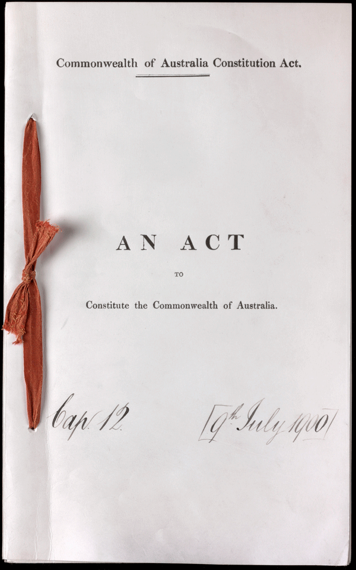

What is a referendum?
A referendum is a vote to change the Australian Constitution
The Constitution is the set of rules by which Australia is run

Slide 5



How to enrol
18 years or over
AND
Driver’s licence
OR
On the AEC website
aec.gov.au
Medicare card
OR
OR
Passport
OR
Citizenship certificate
Visit your local AEC office, and staff there can help you enrol
OR
Someone who is enrolled confirms your identity

Slide 6
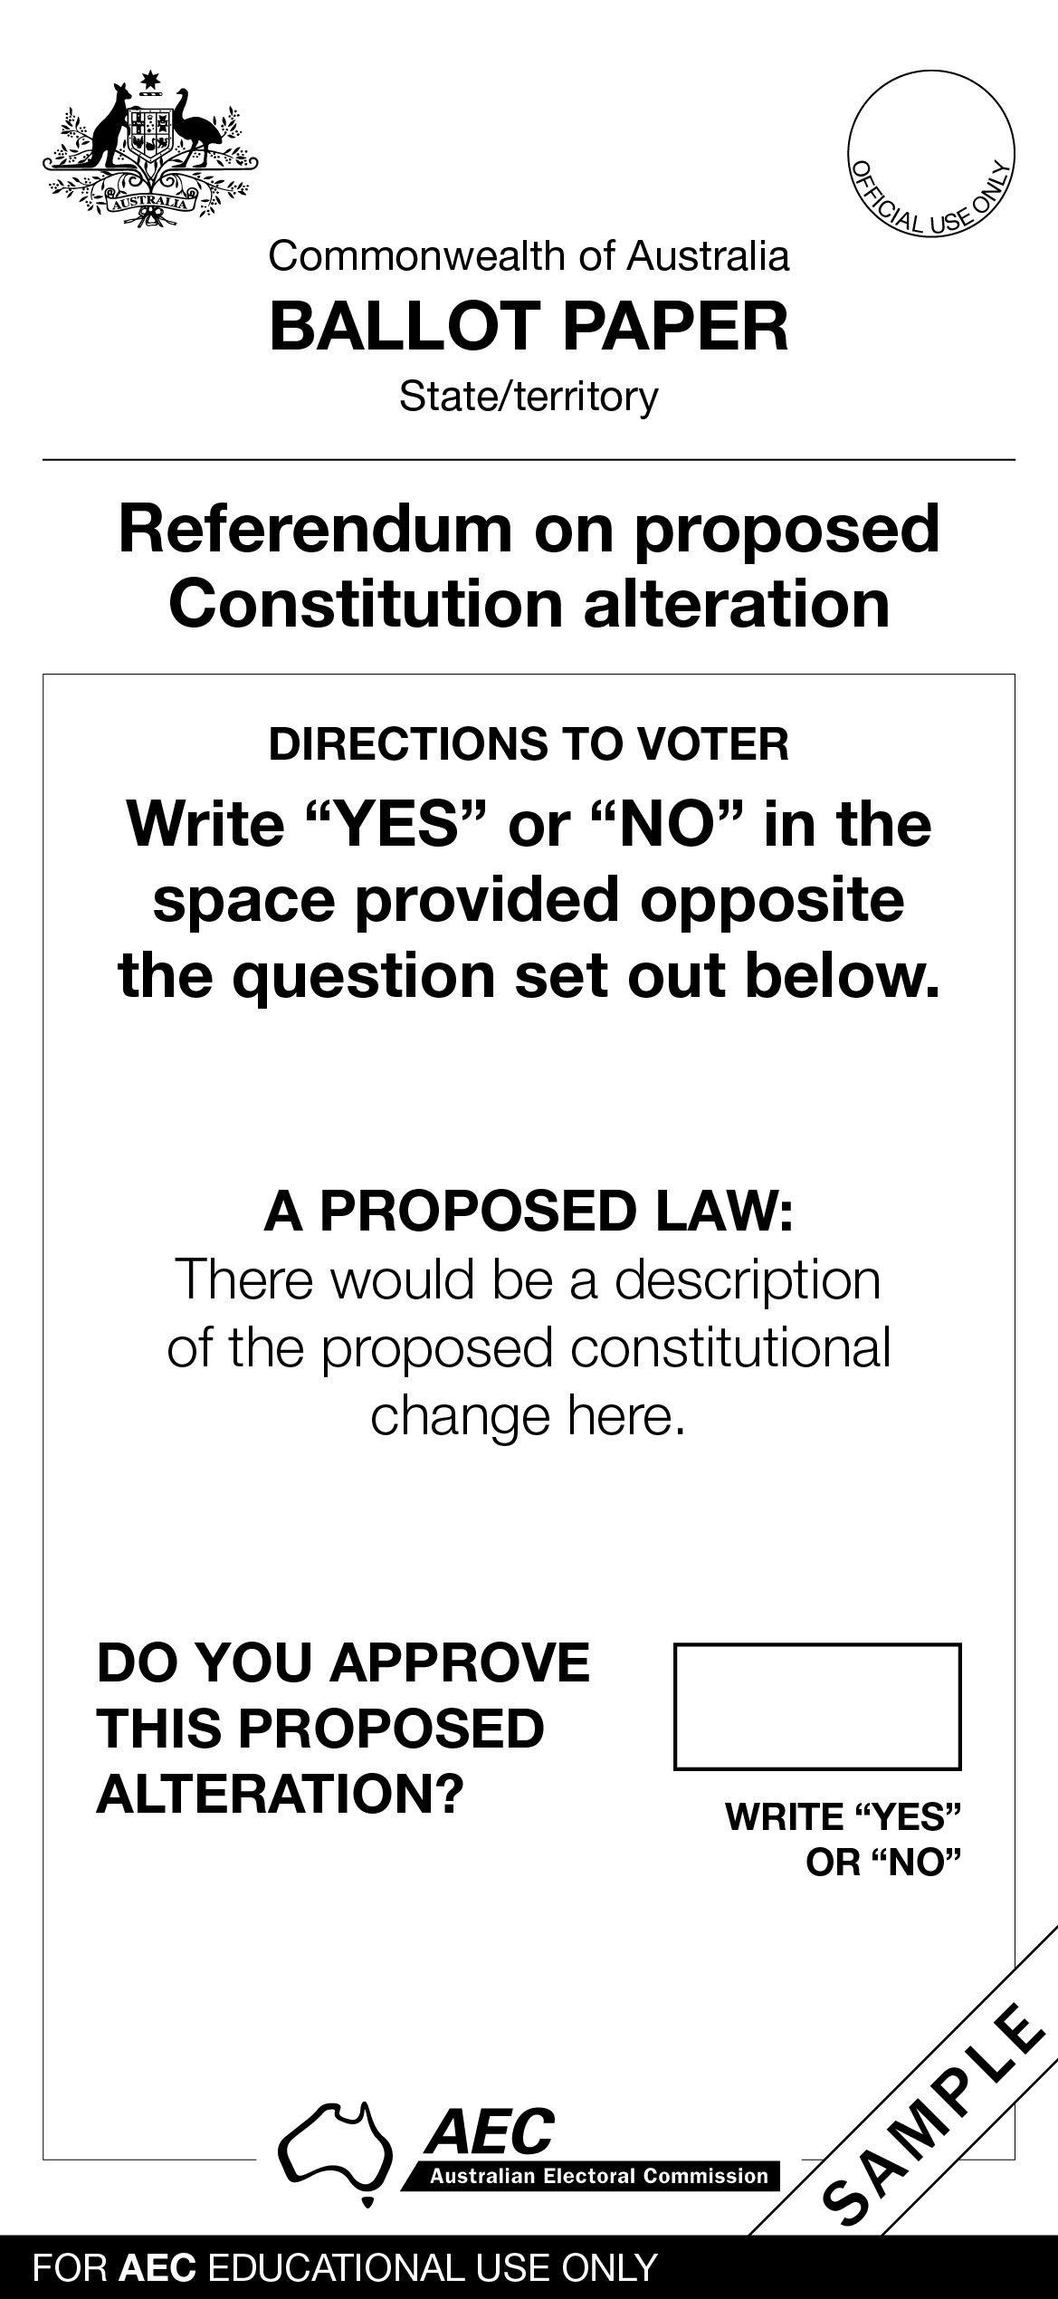
How to vote formally
For your vote to count, you need to follow the instructions on the ballot paper.
You can seek help in the polling place if needed.
Instructions
The question
Write ‘YES’ or ‘NO’ in this box

Slide 7
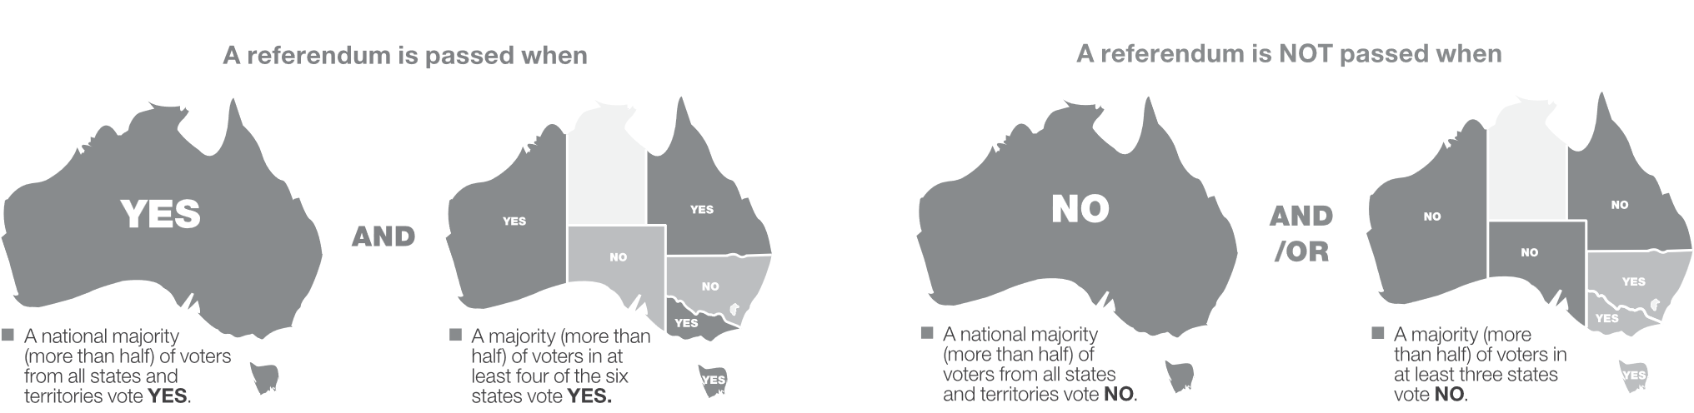
How the vote is counted
The votes of people living in the ACT, the NT and any of Australia’s external territories count towards the national majority only.
For a referendum to be successful it needs to achieve a double majority.

Slide 8



Inform your vote
Stop and consider the source this referendum.
Reliable?
Current?
Safe?

Slide 9

Working at a referendum offers:
Paid work
Short-term employment opportunities
On the job training and support
A unique work experience and an opportunity to gain new skills
Register your interest at aec.gov.au/electionjobs
The opportunity to contribute to your community

